Slide 1
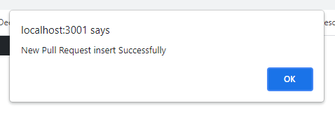
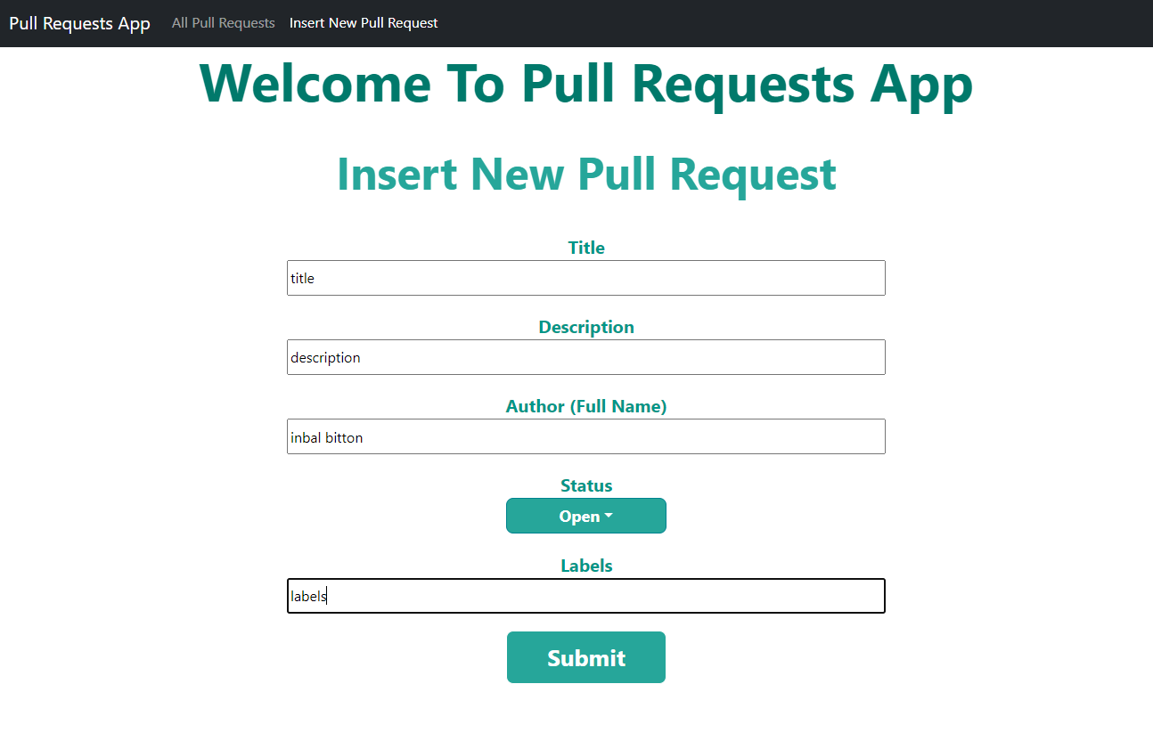
An example of how to fill in the details, after clicking the submit button will appear to us at the top of the document alert if the action was performed successfully or there was a failure and need to perform the action again.

Slide 2
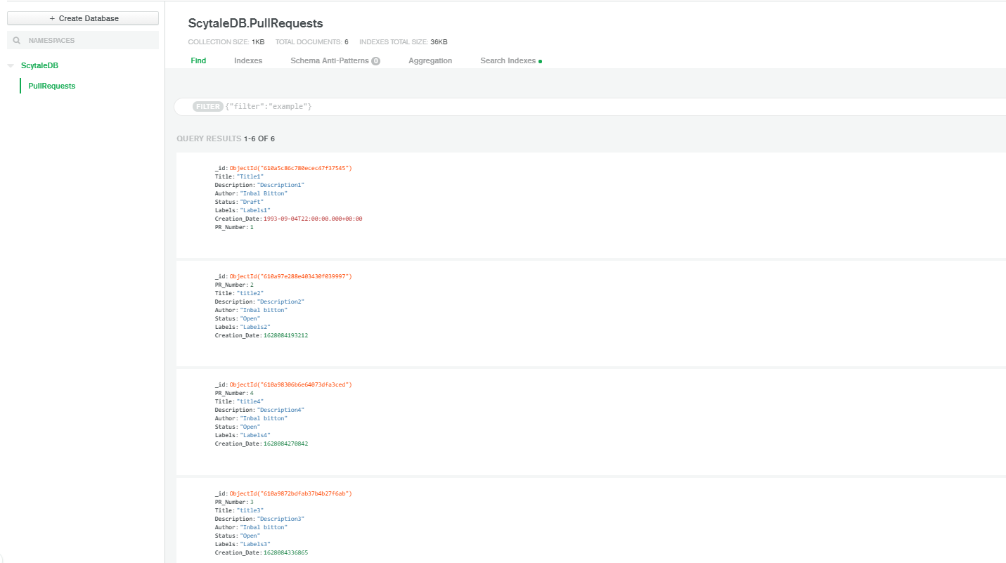
Pull Requests as they appear in the database

Slide 3
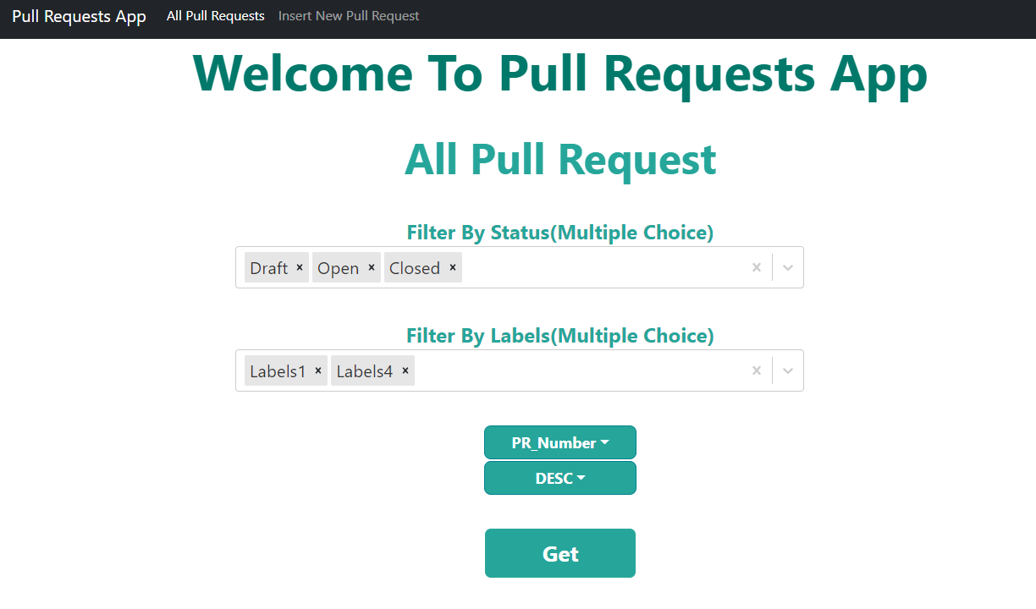
On this page we can view all requests in the system and perform certain filters, according to the status and labels of the requests. The selection is multiple selection and sorting can be done in a desired order.

Slide 4
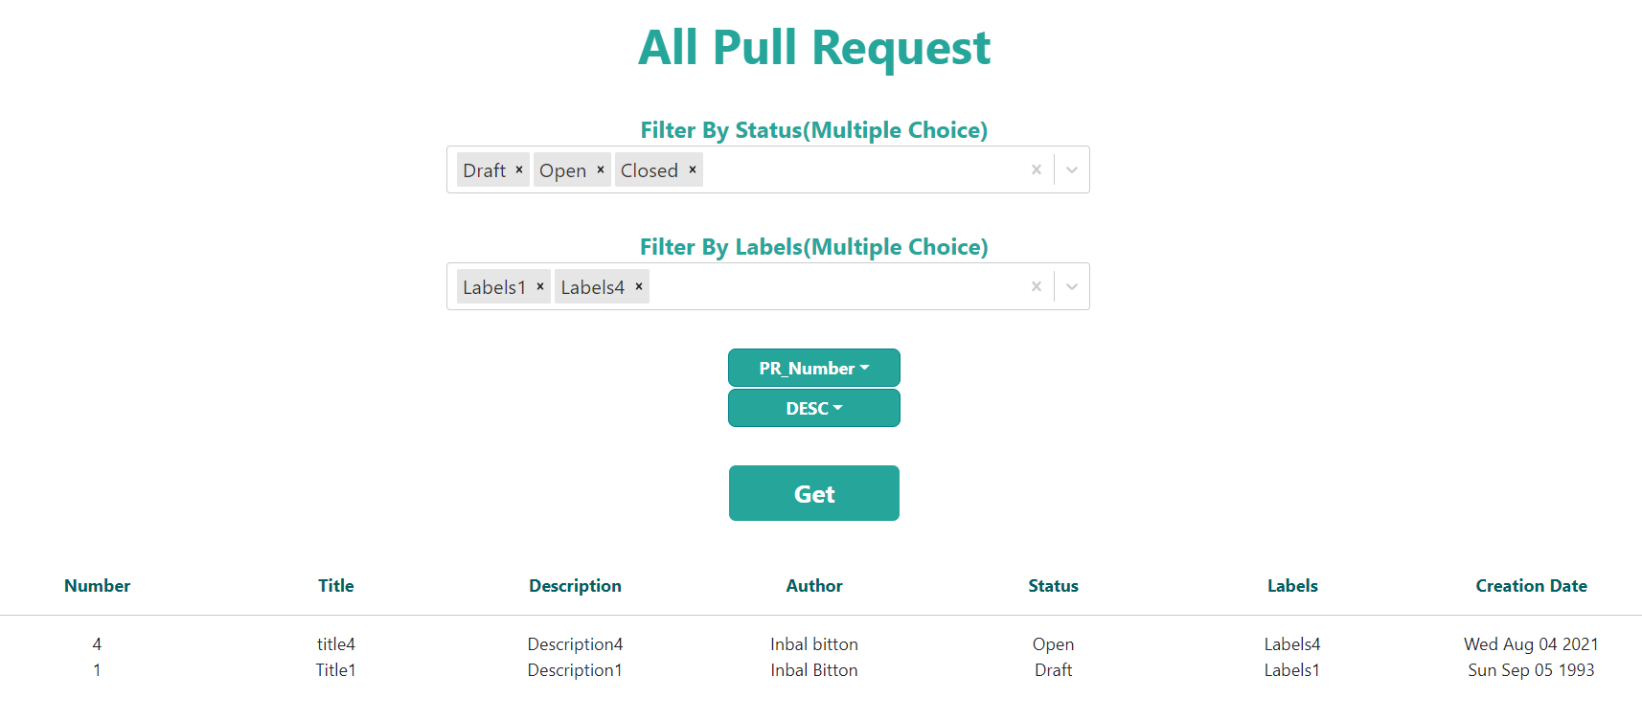
Clicking on the "Get" button will show us the requests according to the parameters entered

Slide 5
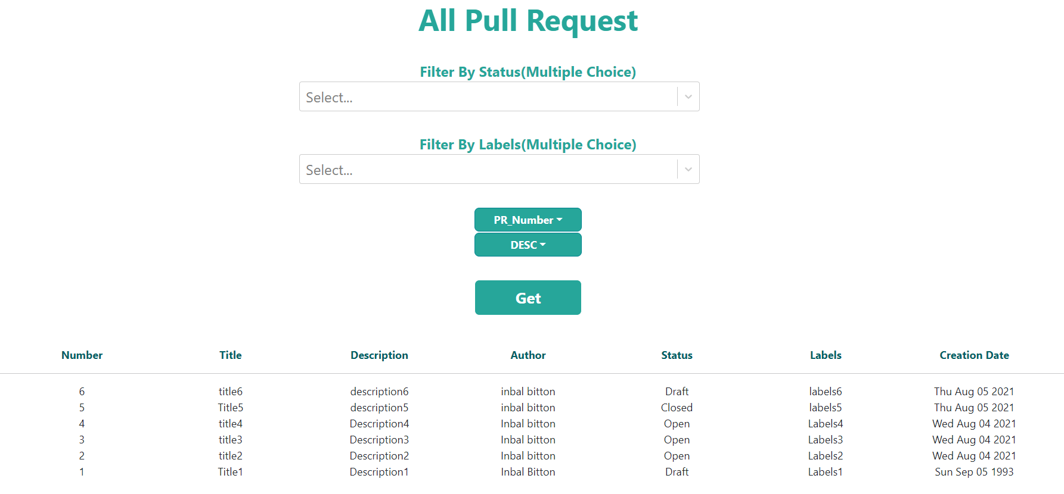
we will note that if no statuses or labels are selected, we will see all the requests.

